Slide 1


The Genetics of Depression
What is Known, What is Next
Eric J. Nestler
Nash Family Professor
The Friedman Brain Institute

Slide 2
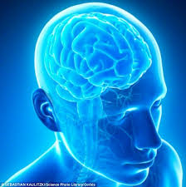
Depression is a Biological Phenomenon
Depression is often categorized as a mental rather than a physical illness.
The brain is an organ, composed of cells and supplied by blood like all other organs.
Our brain cells grow and communicate with one another to control our emotions, memory, and actions.
Sometimes these functions go wrong, leading to illnesses like depression.

Slide 3
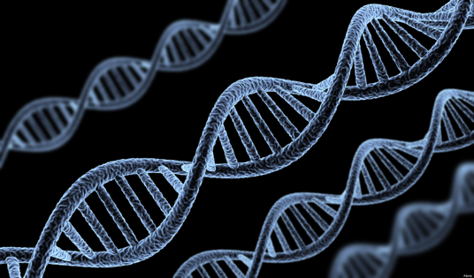
Contribution of Genes to Depression
We want to understand what goes wrong in depression.
To do that, we study the function of genes.
Incredibly powerful new tools to read the genetic code are transforming all of biomedical science, including psychiatry.
DNA

Slide 4

Depression is Heritable
We have long known that depression runs in families.
People who have a parent or sibling with depression are two to three times more likely than the average person to get depression.
This implies the influence of genes passed from parent to child.

Slide 5
However, Genes are Just Part of the Picture
How much is inherited
in the genes?
And how much comes
from life experience?
nature
nurture

Slide 6
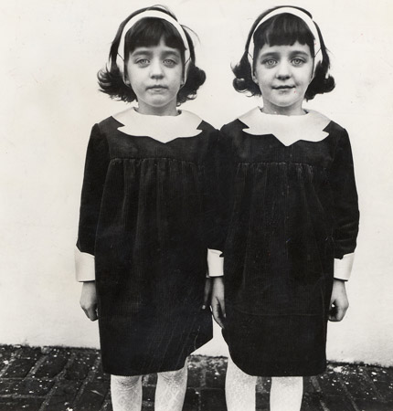
Twin Studies Help Us Understand
the Influence of the Environment (Life Experience)
Diane Arbus, Identical Twins, Roselle, NJ, 1967

Slide 7
Genes and Environment are Both Important:
They Combine to Determine an Individual’s Risk for Depression
Depression is ~35% heritable or genetic.
This is roughly comparable to the genetic risk for high blood pressure or most cancers.
But this means that depression also depends heavily (~65%) on life experiences.

Slide 8
Genes Are Not A Life Sentence
“I don’t want kids,”
she said on The Conversation with Amanda de
Cadenet. “I know that I have this depression and that
it’s in my family.”
- Sarah Silverman (writer, actor, comedian)

Slide 9
Genes Are Not A Life Sentence
We are not prisoners of our genes.
We inherit a genetic vulnerability, but not the certainty of succumbing to an illness.
Very small changes in hundreds of different genes contribute to the development of depression and the effects of these genes can be influenced by our life experiences.

Slide 10
How Does the Environment Control Genes That Lead to Depression?
Life experiences can have both good (protective) and bad effects.
nature
nurture
?

Slide 11
A Very Young Science
We still need to learn about how the diverse conditions in our environment influence risk for depression.
But we are beginning to understand how STRESS, particularly chronic stress, works on a molecular level.
Chronic stress switches a large number of genes ON or OFF in such a way that can lead to depression in people with a genetic vulnerability.

Slide 12
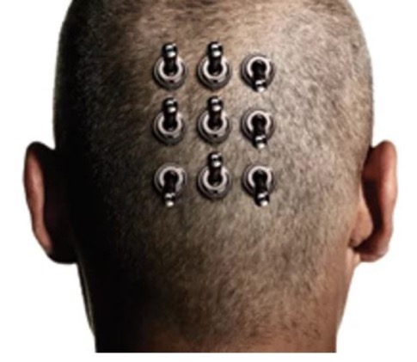
This is Known as the Science of Epigenetics
Molecular switches in the brain
Scientific American
Epigenetics explains how our life experiences turn certain genes
ON or OFF in our brain’s mood areas in a way that can be disruptive and unhealthy or, conversely, protective and pro-resilient.

Slide 13

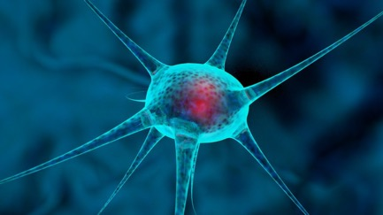
Stress and the Cell
Stress affects the brain, and increases the risk for depression, by changing how our DNA is packaged in particular nerve cells in the brain that control mood.

Slide 14
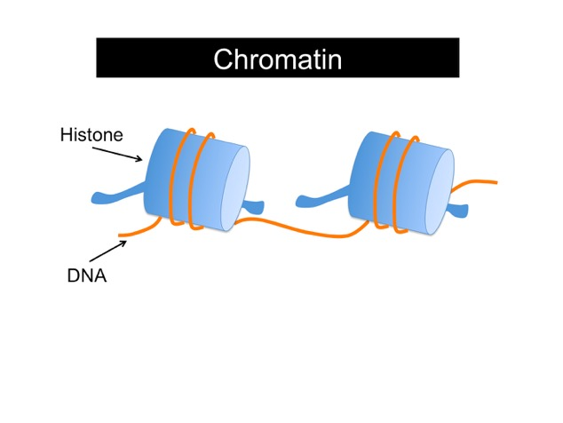
Epigenetics Goes From the Big Picture (Experience) to the Smallest Picture:
The Activity in Each Cell
Within each cell in the body, including nerve cells in the brain, our DNA is wrapped tightly around special “spools”:
Spool (histones)
Spool
DNA
DNA in your cell coupled to spools is called chromatin
Artwork courtesy of Dr. Courtney Griffin

Slide 15
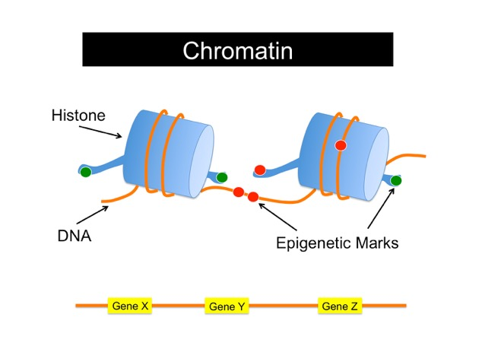
Stress Causes Chemical “Marks” on DNA and Its Spools
We call them epigenetic marks:
Spool (histones)
DNA
Epigenetic marks
DNA in your cell coupled to spools is called chromatin, now showing epigenetic marks
Artwork courtesy of Dr. Courtney Griffin

Slide 16
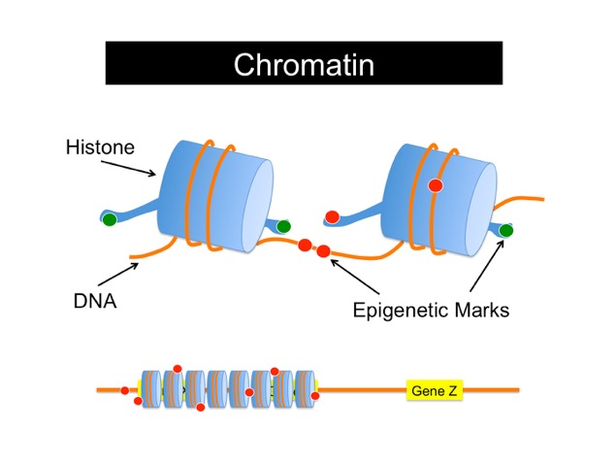
Some Epigenetic Marks Turn OFF a Given Gene, Making it Silent
Spool (histones)
DNA
Epigenetic marks
DNA coiled up so tightly that
the cell doesn’t know the gene is there
Artwork courtesy of Dr. Courtney Griffin

Slide 17
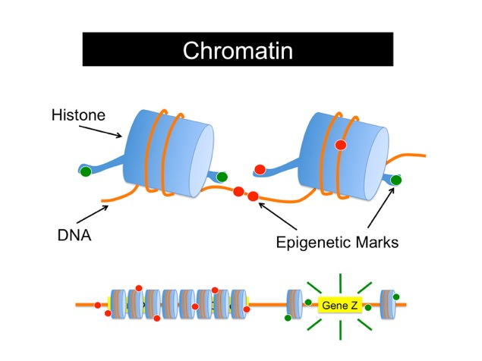
Other Epigenetic Marks Turn ON a Gene, Making it Active and Prominent
Spool (histone)
DNA
Epigenetic marks
The DNA gets loosened on the spool, so the cell sees it!
Artwork courtesy of Dr. Courtney Griffin

Slide 18
Epigenetics Is How Experience – e.g., Stress –
Is Intertwined with Nature
Epigenetics occurs at the molecular level in every cell in our bodies, including nerve cells in the brain’s mood centers.
epigenetics
nature
nurture

Slide 19
How Does Stress in Life Increase One’s Vulnerability to Depression?
Early life stress is one of the strongest known risk factors for depression.
• Four-fold increase in lifetime risk.
• Increased vulnerability to stress later in life.
• Associated with more severe depression that does not respond as well as to standard treatments (talk therapy or
medications).

Slide 20
Studying This Phenomenon in the Laboratory
We exposed lab mice to stress early in life to see if they would become more vulnerable to a depression-like syndrome later in life:
• Separated from their
mothers for 3 hr/day
• Reduced bedding
EARLY LIFE
STRESS
↓
Adult stress
Normal housing
Birth
Analyze
mice
Weaning
Cate Peña et al., Science, 2017

Slide 21
Early Life Stress Enhances Vulnerability to Depression … For a Lifetime
Normal rearing
Early life stress
Normal rearing
Early life stress
Percent of mice with depression-like syndrome
1.0
0.75
Resilient
Developed depression-like syndrome
0.50
*
0.25
Susceptible
0
No adult
stress
Exposed
to adult
stress

Slide 22
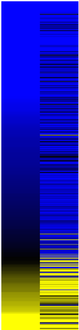
Uncovering What Is Happening
Inside the Cell to Individual Genes
Using a major advance in technology called RNA-sequencing:
Much like a time lapse photo of all the genes switching ON or OFF
as a result of early life stress.
Within a Key Mood Region in Brain
Gene expression in a mouse after early life stress
Gene expression in a normal-reared mouse in a depression-like state due to adult stress
= Genes Turned On
= Genes Turned Off
Early life stress causes a mouse to resemble a mouse in a depressed-like state.

Slide 23

Early Life Stress Primes Genes in the Brain to Increase Vulnerability to Stress Later in Life
Mice stressed early in life have part of the genetic pattern of depression, but they do not appear depressed.
The early life stress primes the genes, such that they are more likely to break if pushed later in life.
How do we find the genes that are responsible for this priming toward depression?

Slide 24
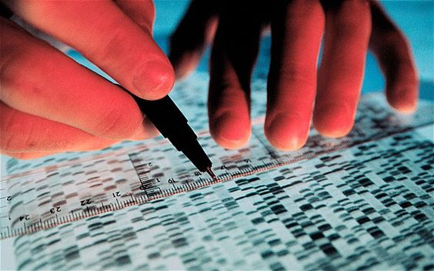
Advanced Bioinformatics at the HDRF Data Center
We used advanced bioinformatics at HDRF’s data center, which is shared by all Depression Task Force laboratories.
Read-outs revealed that a single, novel gene, OTX2, might be responsible for much of the shared gene activity between mice stressed early in life and those with a depression-like syndrome.
We went back to the lab to test this prediction.

Slide 25
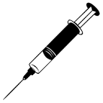
We Turned OFF OTX2 in Young Mice in the Absence of Early Life Stress
A virus is delivered to
the brain’s mood center to block OTX2
Normal housing
Adult stress
Birth
Analyze
mice
Weaning
As predicted, the mice showed increased vulnerability to a depression-like syndrome in adulthood.

Slide 26
Conversely, We Turned ON OTX2 in Young Mice Immediately After Early Life Stress
A virus is delivered to
the brain’s mood center to increase OTX2
EARLY LIFE
STRESS
↓
Normal housing
Adult stress
Birth
Analyze
mice
Weaning
As predicted, these mice showed normal resilience to stress later in life.
Importantly, increasing OTX2 in adulthood has the same effect.

Slide 27

Future Directions
Studies such as this—carried out throughout the Depression Task Force laboratories—are identifying key depression-related genes that we need to know about.
This increasing knowledge has enormous ramifications for treatment and prevention.
Although we are still at the early stages of understanding the powerful molecular interplay between genes and the environment, we know that what we learn will lead to improved treatments and, one day, cures for depression.

Slide 28

Future Directions
In fact, several HDRF discoveries over the past year have led to clinical trials that are now underway.
Each trial will help us better understand the precise molecular mechanics underlying depression, so that we can intervene with more precise and more effective treatments.

Slide 29
Future Directions
Through these uniquely integrated studies, across the seven Depression Task Force laboratories and their clinical collaborators, HDRF is driving transformational advances in depression.
Thank you for your support.

